Slide 1
Sequence Diagram Tutorial
From:
UML Distilled, Third Edition, Chapter 4 M. Fowler

Slide 2
Use Cases and Scenarios
A use case is a collection of interactions between external actors and a system
In UML, a use case is “the specification of a sequence of actions, including variants, that a system (or entity) can perform, interacting with actors of the system.”
Typically each use case includes a primary scenario ( or main course of events) and zero or more secondary scenarios that are alternative courses of events to the primary scenario.
In RUP (Rational Unified Process), user requirements are captured as use cases that are refined into scenarios.
Then: A scenario is one path or flow through a use case that describes a sequence of events that occurs during one particular execution of a system.

Slide 3
UML Sequence Diagrams
Describe the flow of messages, events, actions between objects
Show concurrent processes and activations
Show time sequences that are not easily depicted in other diagrams
Typically used during analysis and design to document and understand the logical flow of your system
Emphasis on time ordering!

Slide 4
Sequence Diagram Key Parts
participant: object or entity that acts in the diagram
diagram starts with an unattached "found message" arrow
message: communication between participant objects
the axes in a sequence diagram:
horizontal: which object/participant is acting
vertical: time (down -> forward in time)

Slide 5
Sequence Diagram (make a phone call)
Caller
Phone
Recipient
Picks up
Dial tone
Dial
Ring
Ring notification
Picks up
Hello
Hello
Notes:
Sequence diagrams generally show the sequence of events that occur

Slide 6
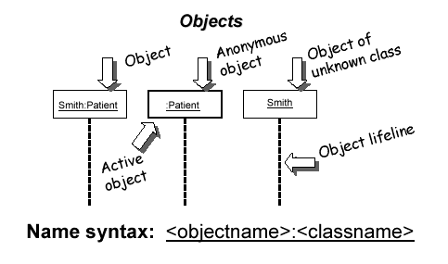
Representing Objects
Squares with object type, optionally preceded by "name :"
write object's name if it clarifies the diagram
object's "life line" represented by dashed vert. line

Slide 7
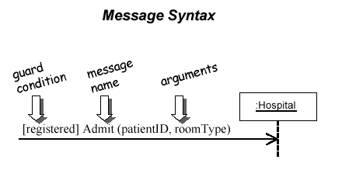
Messages Between Objects
messages (method calls) indicated by arrow to other object
write message name and arguments above arrow

Slide 8
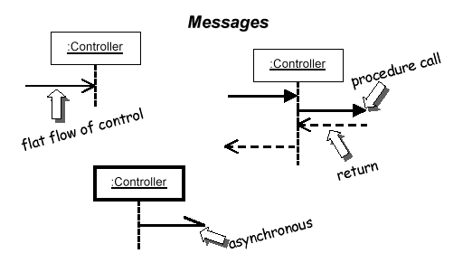
Messages, continued
messages (method calls) indicated by arrow to other object
dashed arrow back indicates return
different arrowheads for normal / concurrent (asynchronous) calls

Slide 9
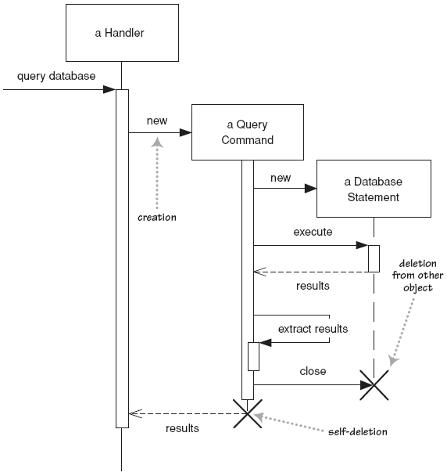
Lifetime of objects
creation: arrow with 'new' written above it
notice that an object created after the start of the scenario appears lower than the others
deletion: an X at bottom of object's lifeline
Java doesn't explicitly delete objects; they fall out of scope and are garbage-collected

Slide 10
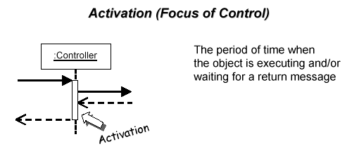
Indicating method calls
activation: thick box over object's life line; drawn when object's method is on the stack
either that object is running its code, or it is on the stack waiting for another object's method to finish
nest activations to indicate recursion
Activation
Nesting

Slide 11
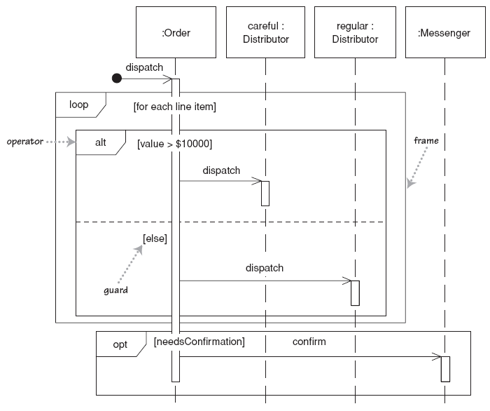
Selection and loops
frame: box around part of diagram to indicate if or loop
if -> (opt) [condition]
if/else -> (alt) [condition], separated by horizontal dashed line
loop -> (loop) [condition or items to loop over]

Slide 12
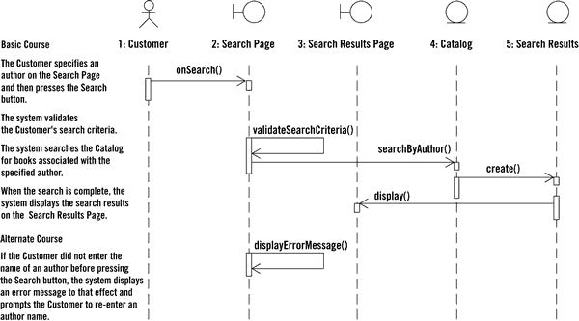
Sequence diagram from use case scenario

Slide 13
Why not just code it?
Sequence diagrams can be somewhat close to the code level.
So why not just code up that algorithm rather than drawing it as a sequence diagram?
a good sequence diagram is still a bit above the level of the real code (not all code is drawn on diagram)
sequence diagrams are language-agnostic (can be implemented in many different languages
non-coders can do sequence diagrams
easier to do sequence diagrams as a team
can see many objects/classes at a time on same page (visual bandwidth)

Slide 14
Sequence Diagram Exercise
Let's do a sequence diagram for the following poker casual use case, Start New Game Round :
The scenario begins when the player chooses to start a new round in the UI. The UI asks whether any new players want to join the round; if so, the new players are added using the UI.
All players' hands are emptied into the deck, which is then shuffled. The player left of the dealer supplies an ante bet of the proper amount. Next each player is dealt a hand of two cards from the deck in a round-robin fashion; one card to each player, then the second card.
If the player left of the dealer doesn't have enough money to ante, he/she is removed from the game, and the next player supplies the ante. If that player also cannot afford the ante, this cycle continues until such a player is found or all players are removed.

Slide 15
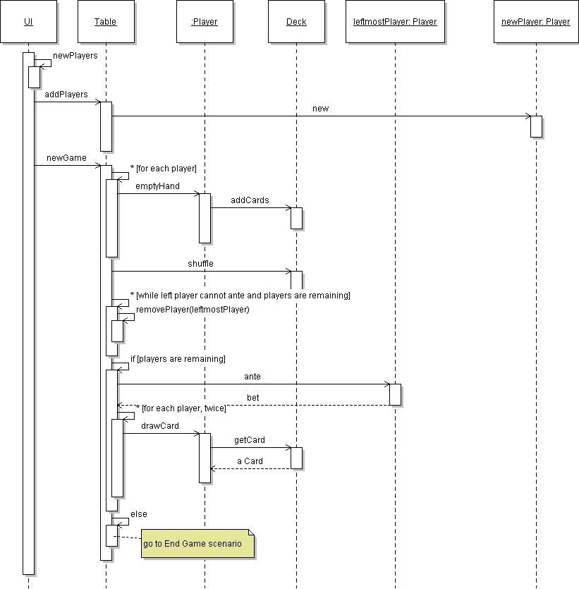
Poker sequence diagram

Slide 16
Sequence Diagram Question
Consider the possible poker use case, Betting Round :
The scenario begins after the Start New Round case has completed. The UI asks the first player for a bet. That player chooses to either bet a given amount, or check (no bet).
The next player is asked what to do. If the prior player placed a bet, the next player must either match ("see") it, or match it plus add an additional bet ("raise"), or choose not to match and exit the round ("fold"). This continues around the table until an entire pass is made in which all players have either matched all other players' bets or folded.
If the next player doesn't have enough money to match the current bet, the player is allowed to bet all of their money. But they can then win only up to the amount they bet; the rest is a "side pot" among the more wealthy players remaining in the round.
Why is it hard to diagram this case as a sequence diagram?

Slide 17
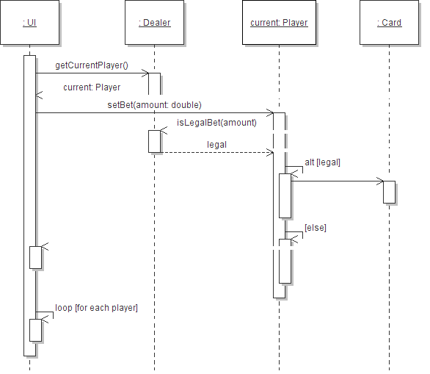
Poker Sequence Diagram 2

